Slide 2

An algorithm is a step-by-step procedure for solving a problem in a finite amount of time.

Slide 3
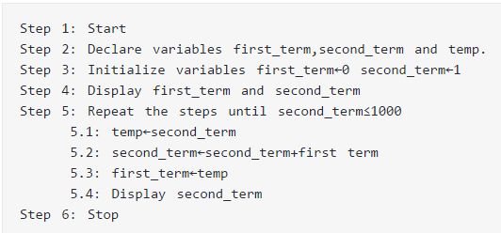

Slide 4

A data structure is a specialized format for organizing and storing data .
General data structure types include the array, the file, the record, the table, the tree, and so on
Any data structure is designed to organize data to suit a specific purpose so that it can be accessed and worked with in appropriate ways.

Slide 5
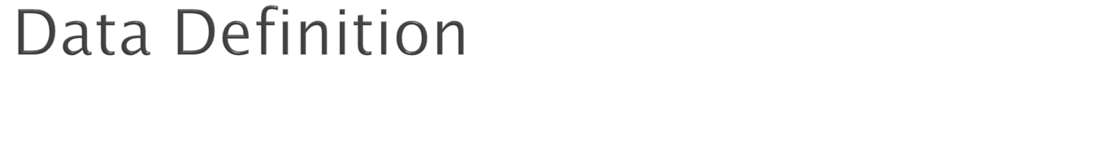
Data Definition defines a particular data with the following characteristics.
Atomic − Definition should define a single concept.
Traceable − Definition should be able to be mapped to some data element.
Accurate − Definition should be unambiguous.
Clear and Concise − Definition should be understandable.

Slide 6

Traversing
Searching
Insertion
Deletion
Sorting
Merging

Slide 7
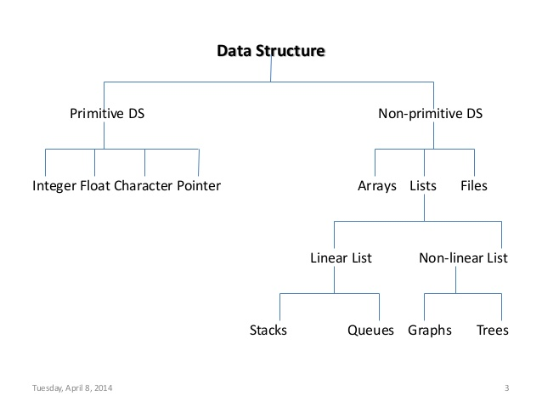

Slide 8

There are numerous types of data structures, generally built upon simple primitive data type
Primitive types
Composite types or Non-primitive type
Abstract data types

Slide 9

Boolean, true or false.
Character
Floating-point, single-precision real number values.
Double, a wider floating-point size.
Integer, integral or fixed-precision values.
String, a sequence of characters.
Reference (also called a pointer or handle), a small value referring to another object's address in memory, possibly a much larger one.
Enumerated type, a small set of uniquely named values.

Slide 10
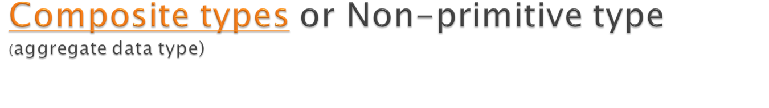
Array
Record (also called tuple or structure)
Union
Tagged union (also called variant, variant record, discriminated union, or disjoint union)

Slide 11

Container
List
Associative array
(associative array, map, symbol table, or dictionary is an abstract data type composed of a collection of (key, value) pairs, such that each possible key appears at most once in the collection.)
Multimap
(a multimap (sometimes also multihash or multidict) is a generalization of a map or associative array abstract data type in which more than one value may be associated with and returned for a given key)

Slide 12

Set
Multiset (Bag)
Stack
Queue
Double-ended queue
Priority queue
Tree
Graph

Slide 13
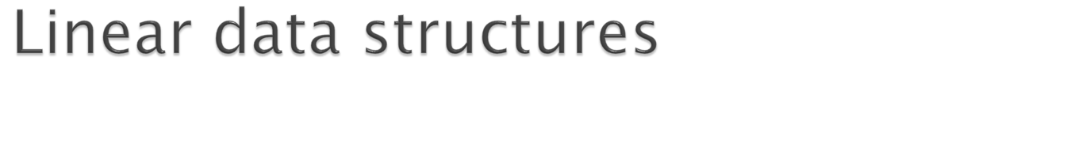
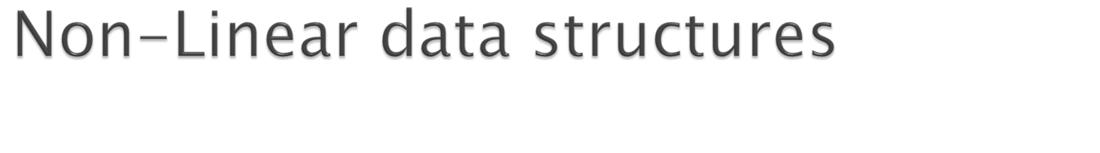
Array
Linked List
Stack
Queue
Tree
Graph

